Slide 1



Piping International T.A.P.I. Web application
Permanent Communication

Slide 2

Permanent Communications
Project Team
CHAD JOHNSON
Project Manager
JOSE ZELAYA
Assistant Project Manager
NOAH HENDRICKS
Lead Database Developer
KYLE CORTEZ
Lead Application Developer
VICTOR NGUYEN
Lead Support Analyst

Slide 3

Table of contents
Client Introduction
Current System and Analysis
Project Objectives
Project Solution
Application Demo
Lessons Learned
Project Summary
Questions and Answers

Slide 4
Client introduction

Slide 5
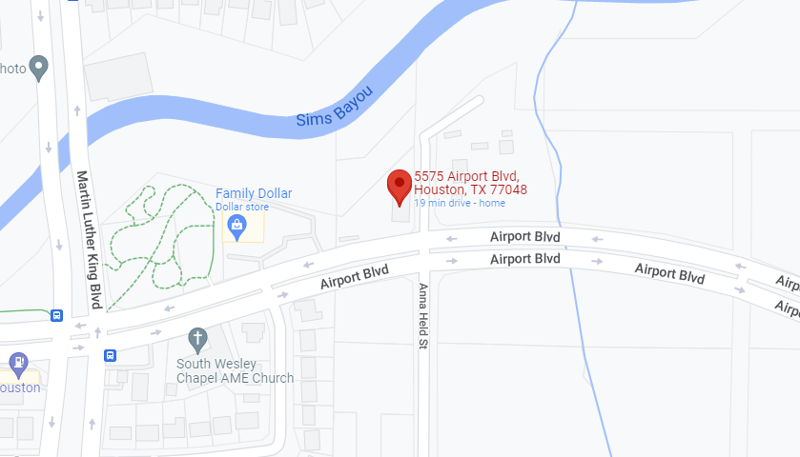
Client background
Sole proprietary owner
Primary focus is on fabrication jobs
Secondary focus on custom home building
Located on Airport Blvd. on the south side of Houston
Notes:
Presenter: Chad Johnson
Piping International is a Sole proprietary owner fabrication business. Their primary focus is on fabrication services, while the secondary focus is on custom home building. Piping International is located off Airport off the south side of Houston.
-Owned and operated by Terry Alleyne.
-Opened in January 2014 after working as a plant operator.
-Today he operated out of his warehouse he built on his own.
-Piping international had jobs across Houston to include jobs at IAH.
-Due to the slow fabrication job during Covid, Terry started to build houses

Slide 6
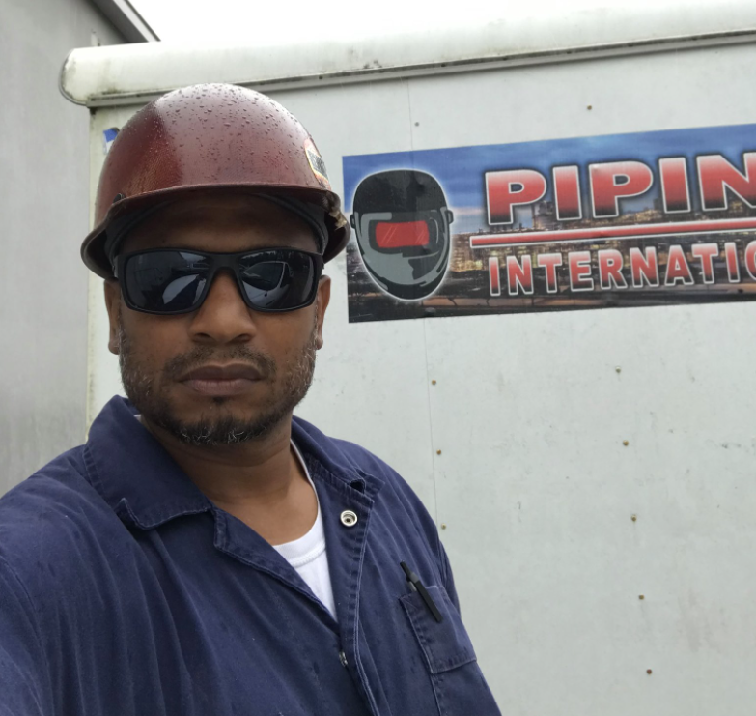
Client Organization
Terry Alleyne
Notes:
Presenter: Chad Johnson
Moving on to the client organization, Terry Alleyne is the owner of the company.

Slide 7
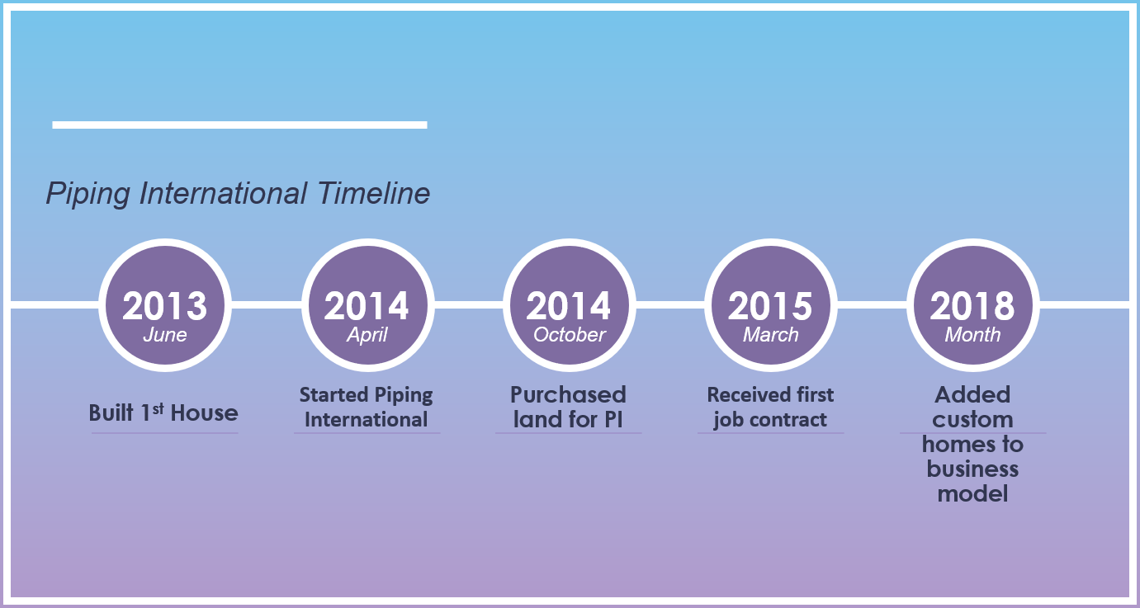
Piping international timeline

Slide 8
SWOT ANALYSIS
Highly Efficient
Experienced Builder
Cheap labor Costs
Experienced Subcontractor
Lack of Technology
High production Cost
Unregistered contractors
Future projects
Hiring Project Managers
Follow latest trends
Competitive Industry
Weak Economic Outlook
Weather Conditions
Covid Quarantine
S
W
O
T
strengths
weaknesses
opportunities
threats

Slide 9
Current system

Slide 10
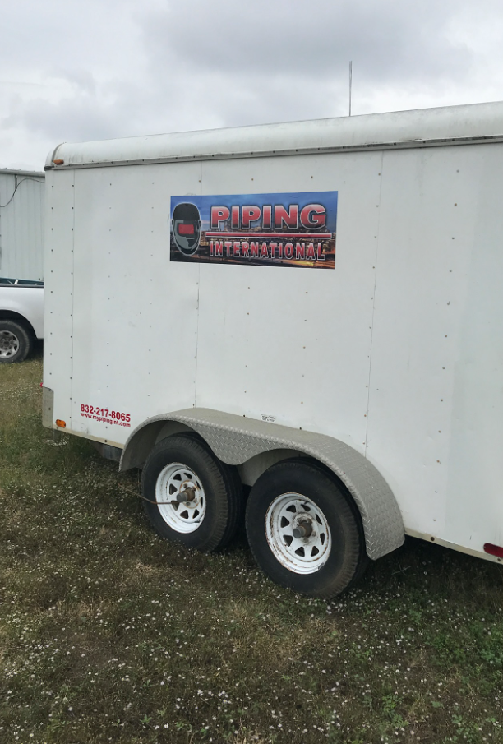
Current system
Pen and paper system
Excel spreadsheet
Phone calls, texts, and email
Previous project stored in various folders

Slide 11
Current system likes
Low overhead
Pen and paper is easy & familiar

Slide 12

Current system dislikes
Project estimations take too long
Misplaced projects
Spread out across multiple systems
Doesn’t scale
No Technology
Missing Project Steps

Slide 13
What’s the Problem?
Incomplete Estimates
Decentralized
Records
Inconsistent Projects
Missed items

Slide 14
Project objective

Slide 15
Project objective
Reduces missing items in a project
Reduces missing tasks in a project
Reduces estimating errors
Time tracking tasks reduced by 25% Lost revenue reduced 40% Estimating errors reduced by 80%
Create a Web Application

Slide 16
Project scope: In Scope
Create & Modify Projects
Create & Modify Employees
Investor Information
Subcontractors Information
Assignment of Project Personnel

Slide 17
Project scope: Out Of Scope
Supplier Information
Realtors Information
Pagination
on webpages
Third party software integration
Reports on the Dashboard

Slide 18

High level requirement
1. Data Inputs and CRUD Functionality
2. Application Reporting
3. Data Integrity & Cost Reduction
4. Technology Access of the Application
5. Application Durability/Reliability/Resilience
6. Application Style and Consistency
7. Data Defaults and Simplicity

Slide 19
Project solution

Slide 20

Proposed solution
Custom Web-based Application
Project Management (WBS) Application
Investor, Subcontractor & Employee Integration
Queries and Reports
Local MongoDB Database
Ease of Use | Fast Deployment
Flexible and Scalable

Slide 21
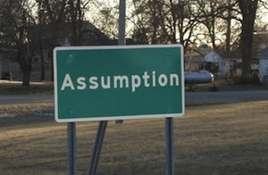
Assumptions
Resources
Scope
Cost
Delivery
Schedule
Technology

Slide 22

Constraints
Project due date April 12th, 2022
Application installed at two locations
Client training
Small project team

Slide 23
Implementation cost breakdown
Source: | Amount:
Permanent Communications Project Team | $22,890
Client | $1,200
Professor Detillier | $4,500
Will Rubit | $225
UH Discount | ($27,615)
Total Implementation Cost: ($1,200)

Slide 24
Annual cost breakdown
Source: | Amount:
Licenses | $1,480
Equipment Upgrades | $950
Maintenance | $360
Printing Costs | $692
Total Operational Cost per year: $3,482

Slide 25
Tangible benefits
Lower dependency on physical documents
Save projects to local computer
Less time on estimating projects
Faster project completion times

Slide 26
Intangible benefits
Improved project quality
Better working relationships with investors
Boosts in customer satisfaction

Slide 27
Projected savings
Year 0 Implementation Costs ($1,200)
Year 1 Total Savings $45,353
Year 2 Total Savings $49,027
Year 3 Total Savings $50,378
Year 4 Total Savings $52,530
Year 5 Total Savings $53,331

Slide 28
application demo

Slide 29
Project summary

Slide 30
Project results
Web-based Application
Bye-Bye to Storing Documents
Less Time on Estimating Projects
Faster Project Completion Times
Missing Items
Inconsistent Projects
Lengthy Estimating Time
Slow Project Completion

Slide 31
Future improvements
Add
Add a button to turn reports into pdf format
Migrate
Migrate the application to the cloud
Build
Build a functional dashboard with reports
Develop
Develop project charts to the application
Implement
Implement predecessor validation
Notes:
Add validation

Slide 32
Lessons learned

Slide 33
Project development lessons learned
What worked?
Vue.js for client-side web development
GitHub Repository
Creating new projects
Project reports

Slide 34

Project development lessons learned
What didn't work?
Screen-sizing
Reports on the dashboard
Pagination on the data tables

Slide 35

Project development lessons learned
What can be done differently?
Cloud integration
Dynamic webpages
Charts and graphs

Slide 36


Project management lessons learned
What went right?
A
Excellent communication with the Project Team
B
Successfully built a working application
C
Relentless effort to complete the project by the Project Team
D
Tremendous support from our project sponsor
Please choose the best answer

Slide 37
Project management lessons learned
What were the challenges?
A
Limited knowledge in Microsoft SQL & Oracle Databases
B
Resource constraint with Project Team of 5
C
Extremely short timeline for the project
D
Keeping the team focused and motivated
Please choose the best answer

Slide 38
Project management lessons learned
What can be done differently?
A
Understand, its better to be done than to be perfect
B
Project Team must include 6 or more students
C
Extend the timeline for the project
Please choose the best answer

Slide 39
Project summary
Problem
Objective
Create a project estimating web-based database application
Solution
Requirements
If a solution existed, improvements can be expected
No solution if it does not relate to the business objective
Permanent Communications created a purpose-built web application
Piping International has problems with estimating and tracking projects

Slide 40
Any Questions?

